Slide 1

VEL TECH HIGH TECH Dr. RANGARAJAN Dr. SAKUNTHALA ENGINEERING COLLEGE An Autonomous Institution
Department of Information Technology
Fishing boat activity clustering and timeline studying
Student 1 Name: Nithyanantham.R
Student 3 Name: Arvindhan.G
II Year, Information Technology
Supervisor
Name :Ms.S.Mangalapriya
Designation : A.P/IT

Slide 2
MULTI-PATTERN FINGERPRINT SECURITY SYSTEM
Introduction:
In recent years, the global demand for seafood has grown significantly, placing unprecedented pressure on marine ecosystems and fisheries resources. To ensure the sustainable management of these vital resources, it is crucial to gain a comprehensive understanding of fishing boat activities – where they occur, when they occur, and how they evolve over time. Fishing boat activity clustering and timeline studying present innovative approaches that harness advanced data analytics techniques to uncover patterns and trends in fishing behaviors. By integrating satellite-based tracking data and employing sophisticated analysis methods, this research aims to provide valuable insights into the spatial distribution and temporal dynamics of fishing activities. Ultimately, this approach holds the potential to revolutionize fisheries management strategies, optimize resource allocation, and promote responsible fishing practices, contributing to the preservation of marine ecosystems for generations to come.

Slide 3
DRAWBACKS
Lack of information about small vessels in the sea
Lack of weather condition reports
No patterned behavior in fishing data.

Slide 4
IOT BASED MULTI-PATTERN FINGERPRINT SECURITY SYSTEM
Objective:
The objective of this study is to utilize fishing boat trajectory data and advanced clustering techniques to identify distinct spatial fishing zones and hotspots. Additionally, the study aims to analyze temporal patterns in fishing activities through timeline analysis, unveiling diurnal, seasonal, and annual trends. By integrating spatial clustering and timeline insights, the research seeks to enhance fisheries management strategies, optimize resource allocation, and promote sustainable and responsible fishing practices.

Slide 5
PROPOSED PATTERN & ADVANTAGES
The proposed system “Multi-pattern fingerprint security system” improvises the method of fingerprint recognition which includes combinations of multiple fingerprint which results in a complex pattern. Thus the system uses an Arduino UNO board to access the data , where the data is collected from the fingerprint scanner from the user of different fingers in series is been and applied or saved onto the data in the database (SQL server), thus the modification of finger data requires verification of the person who is been the user in this case, the following images and code explains the proposed system briefly. Thus this advancement also tends in cost effectiveness, security of ones data and accessibility.
ADVANTAGES:
Justifies possible protection by including both the causes in the existing method that is uniqueness and combination
Could affirm high-rated protection and security
Not easy to breach one’s data because requires a lot of data to breach itself

Slide 6
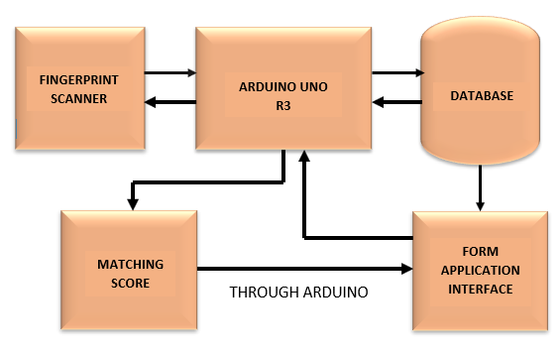
MULTI-PATTERN FINGERPRINT SECURITY SYSTEM
Block Diagram/Flowchart:

Slide 7
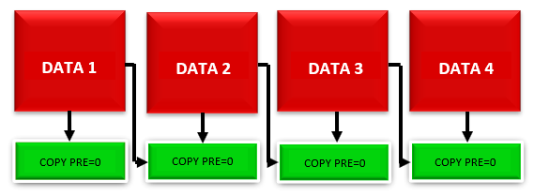
STORING AND RETRIEVING OF BIOMETRIC

Slide 8
METHODOLOGY
Arduino setup
Login Form
Registration catalog
Fingerprint scan form
Fingerprint verification form
Database connection

Slide 9
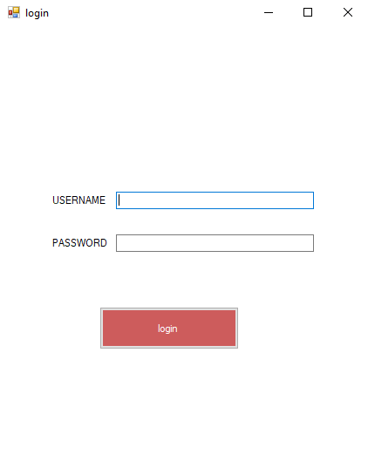
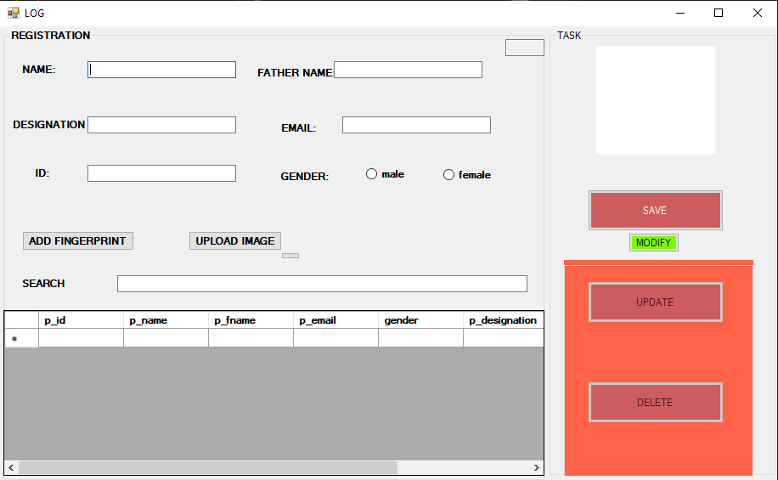
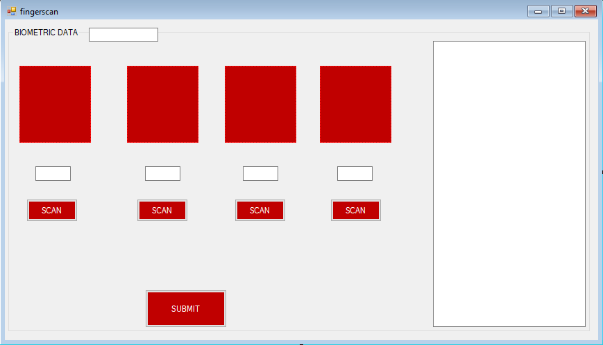

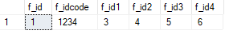

WORKFLOW
MANIPULATION CHECK SCAN
DATABASES
REGISTRATION
FINGERCODE
LOG IN

Slide 10
MULTI-PATTERN FINGERPRINT SECURITY SYSTEM
Requirements (Materials/Components, Hardware/Software):
Arduino Uno R3
Fingerprint sensor
Arduino IDE in c# language
Windows form application (visual studio)
Microsoft SQL server management studio

Slide 11
CONCLUSION
In this advanced technological world, the data of one individual can be shared over the network very easily even though many security systems have certain limitations of work which can be easily biased which leads to data leakage. So we collectively gathered information on the protection enhancement of data and developed the multi-pattern fingerprint security system which can stand as a firewall for the data stored in any kind of database. This is the more enhanced, improvised security system that we deliver for one individual’s privacy.

Slide 12
REFERENCE PAPERS
The Research of Double-biometric Identification Technology Based on Finger Geometry & Palm print. Authors: Lang Zhai, Qi Hu. IEEE - 2011
Finger-Knuckle-Print Recognition Using Deep Convolutional Neural Network
Authors: Selma Trabelsi, Djamel Samai, Abdallah Meraoumia, Khaled Bensid, Azeddine Benlamoudi, Fadi Dornaika, Abdelmalik Taleb-Ahmed. IEEE – 2020
Finger vein recognition based on Deep Convolutional Neural Networks.
Authors: Lecheng Weng, Xiaoqiang Li, Wenfeng Wang. IEEE – 2020
A Novel algorithm for Secure Internet Banking with finger print recognition.
Authors: R. Priya, V. Tamilselvi, G.P.Rameshkumar. IEEE – 2014
Biometric Authentication Using Palm Dorsal Vein Patterns.
Authors: Yutthana Pititeeraphab, Chuchart Pintavirooj. IEEE - 2019

Slide 13
Thank you

